Slide 1
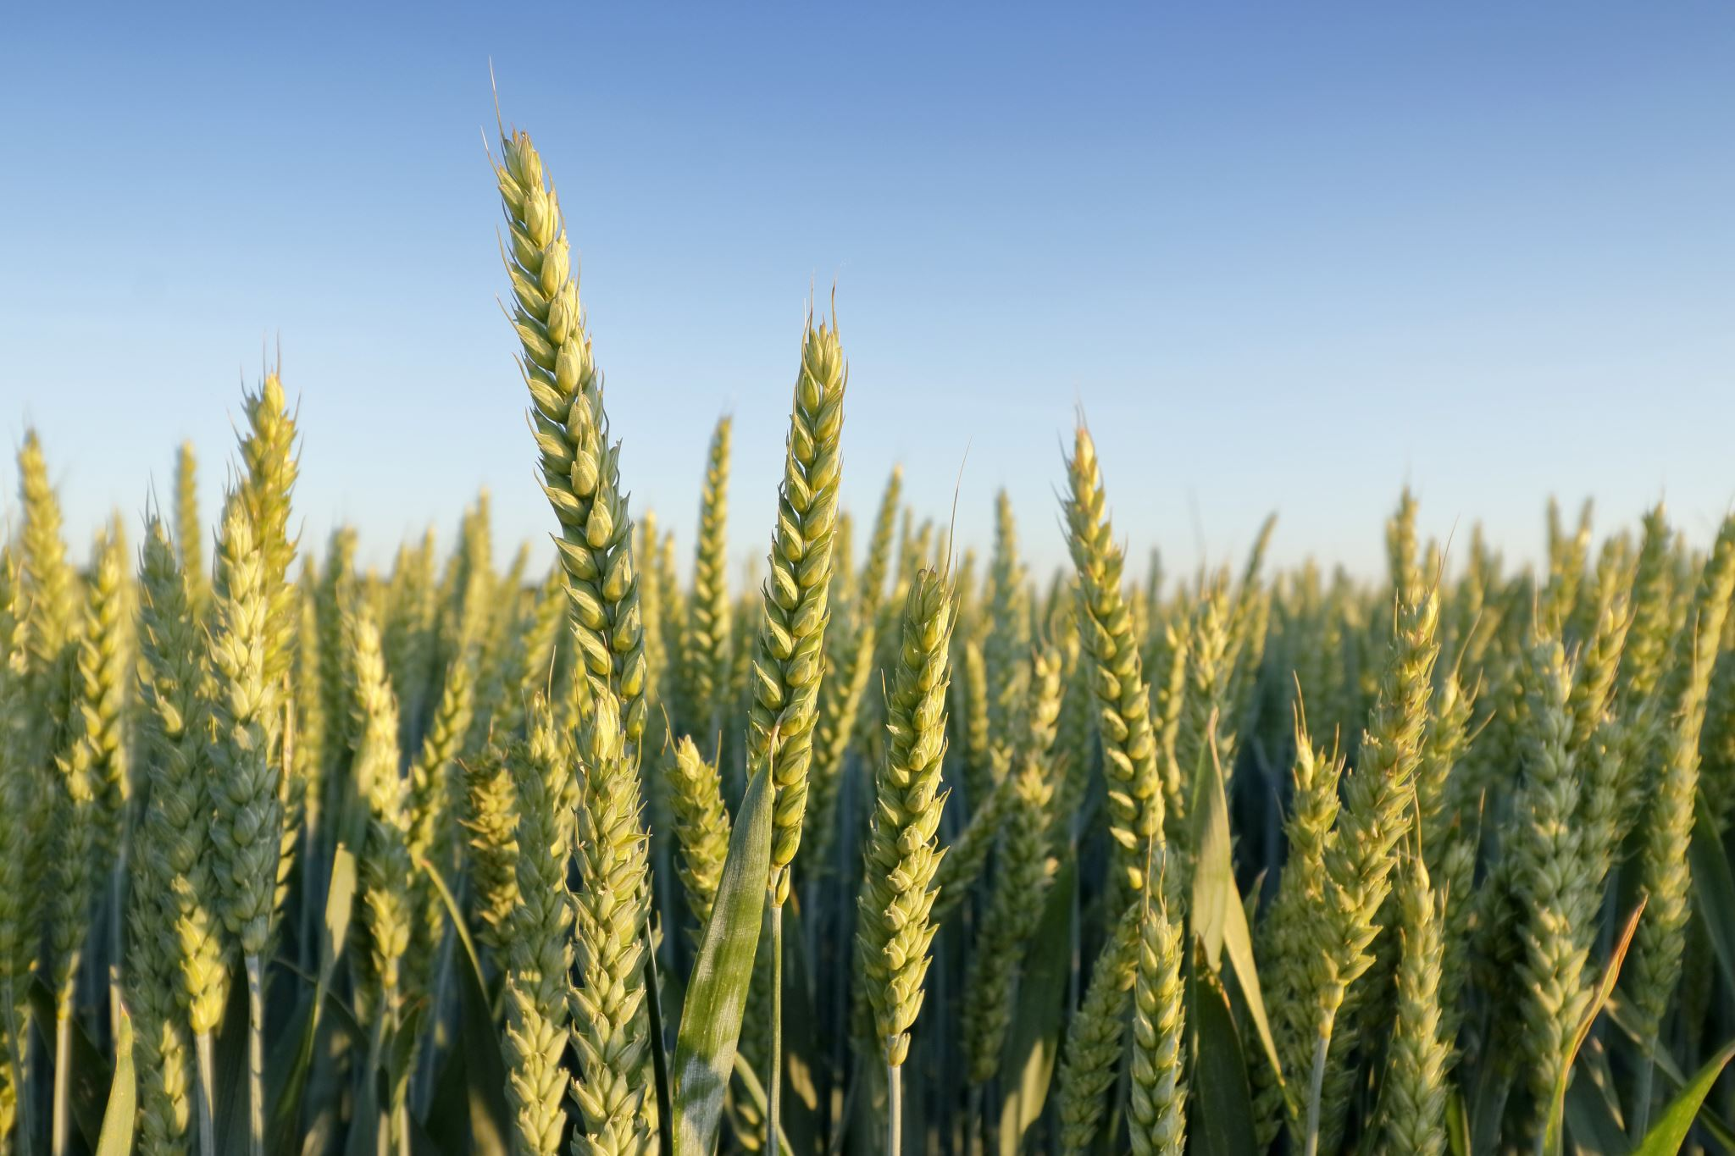
Crop Yield Prediction in India
Rishabh Awasthy
Cs-668
ra35976n@pace.edu
github: - https://github.com/awsthy/Cs-668-Capstone-Project

Slide 2
Research Question: -
Can we predict crop yield per acre, using data on farming practices and environmental conditions?

Slide 3
Literature Review
There are total of 8 pages in the literature review from which i learn various technique and the methods for my project. The model include involves employing a Deep-LSTM model with forget, input, and output gates to process the data. The results indicate that the proposed model outperforms existing methods, with a lower RMSE value, showcasing its effectiveness.
There are also data mining and machine learning techniques that are employed to predict optimal crop cultivation based on factors such as soil, weather, and nutrient conditions. The dataset is collected from various sources, including Kaggle and agricultural databases. Various machine learning techniques like k-Nearest Neighbors, Naïve Bayes, Support Vector Machine, and Linear Regression are used. The research aims to provide valuable insights for farmers and governments to enhance agricultural practices and yield optimization.
And SCA-WRELM technique, targeting efficient rice crop productivity forecasting. The dataset used is a previous SCA-WRELM dataset, and the methodology involves data normalization and the utilization of the WRELM model, optimized using SCA for parameter tuning. The results demonstrate improved predictive outcomes compared to existing methods.

Slide 4
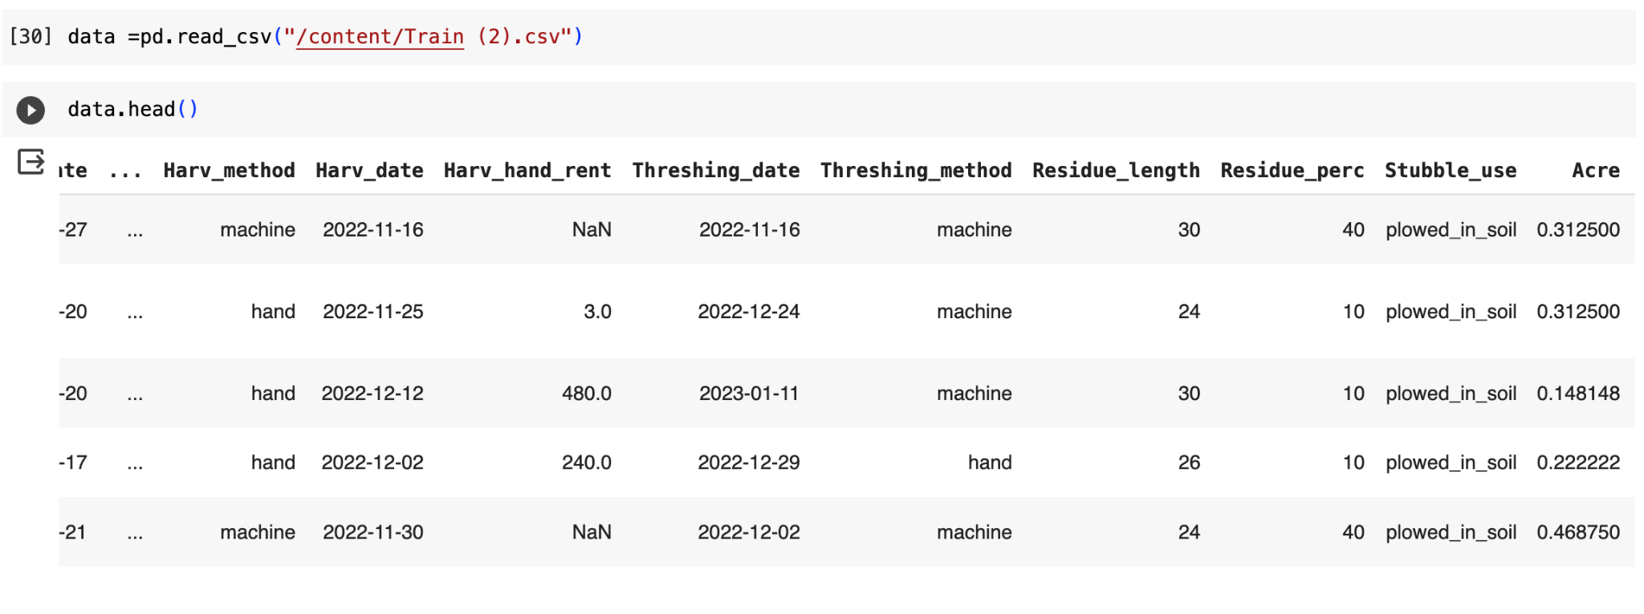
Dataset: -
Link to the data: - https://zindi.africa/competitions/digital-green-crop-yield-estimate-challenge
Description : - This dataset seems to capture detailed information about various agricultural activities in India year 2022, including land preparation, cultivation methods, irrigation, fertilization, harvesting, and related factors. It could be useful for analyzing and optimizing agricultural practices in the specified districts and blocks.
Size: - There are 3870 rows and 45 columns in the dataset.

Slide 5
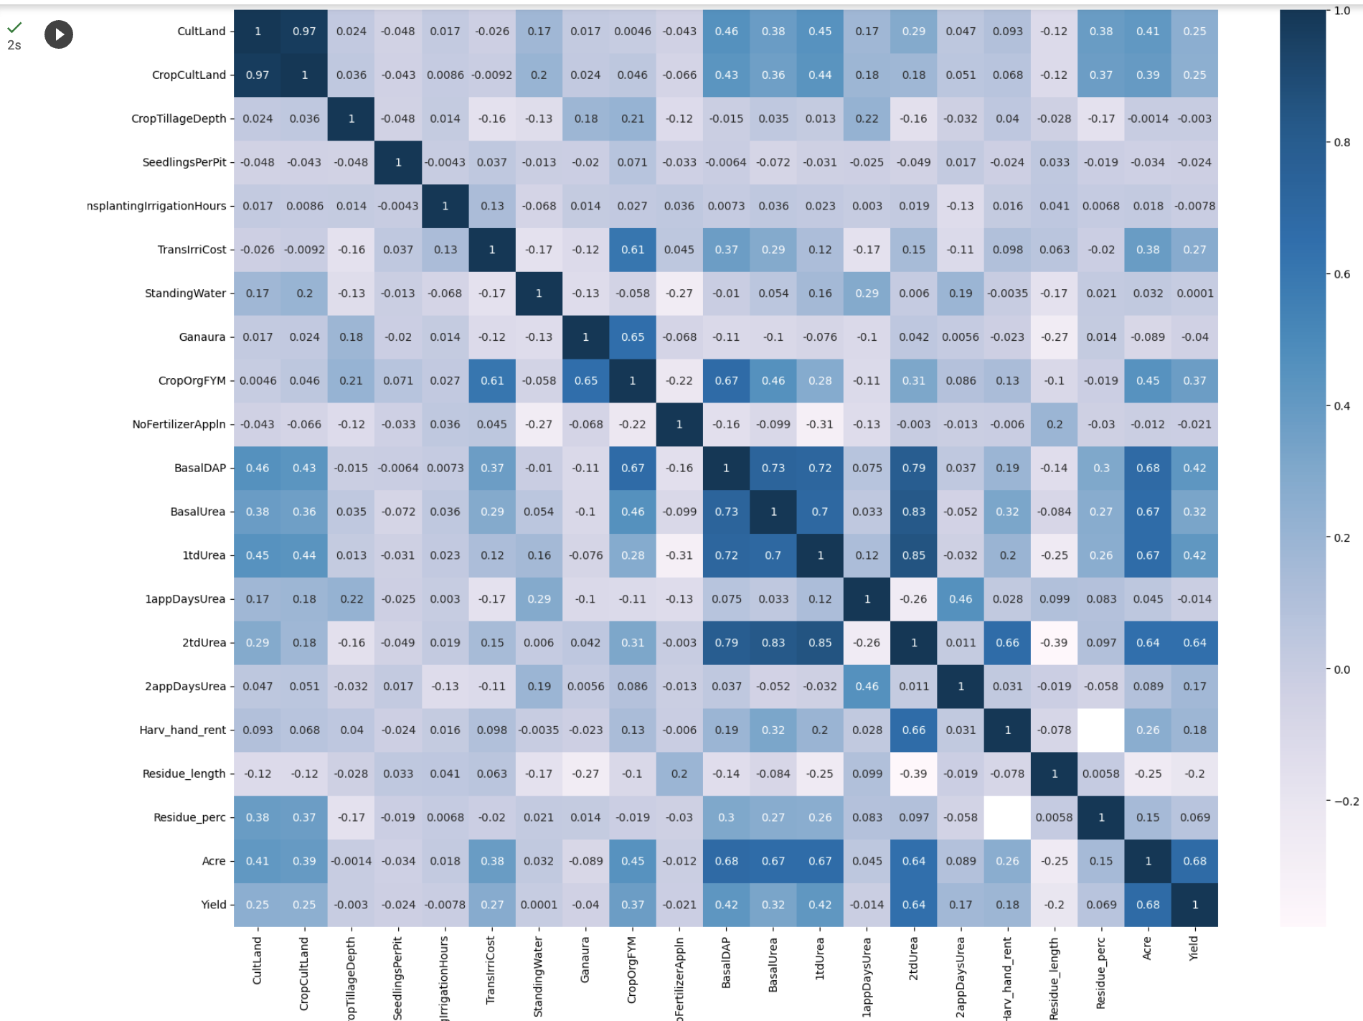
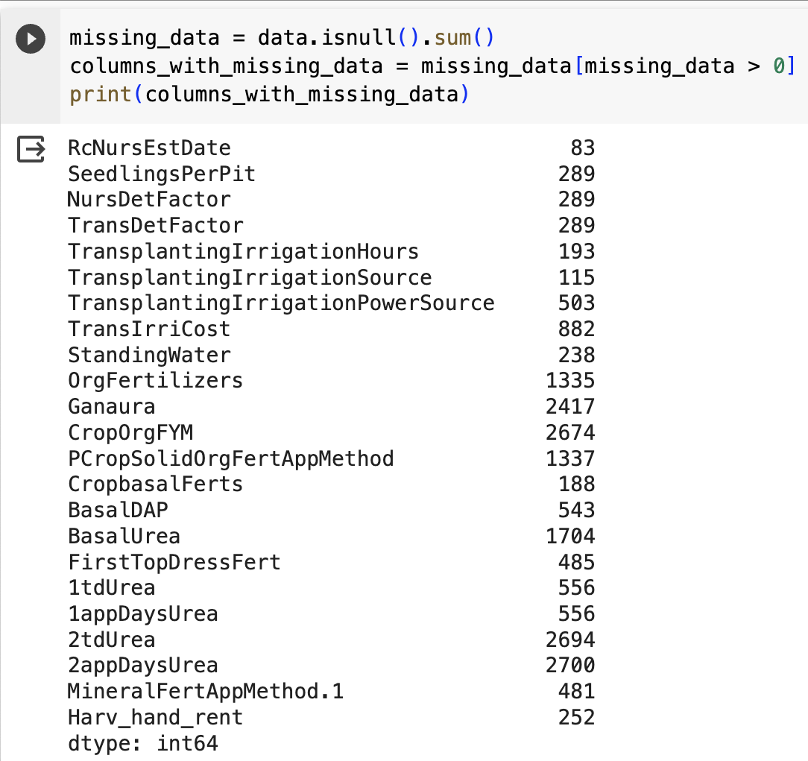
EDA and Methodology
Null values and the correlation Graph of the data set

Slide 6
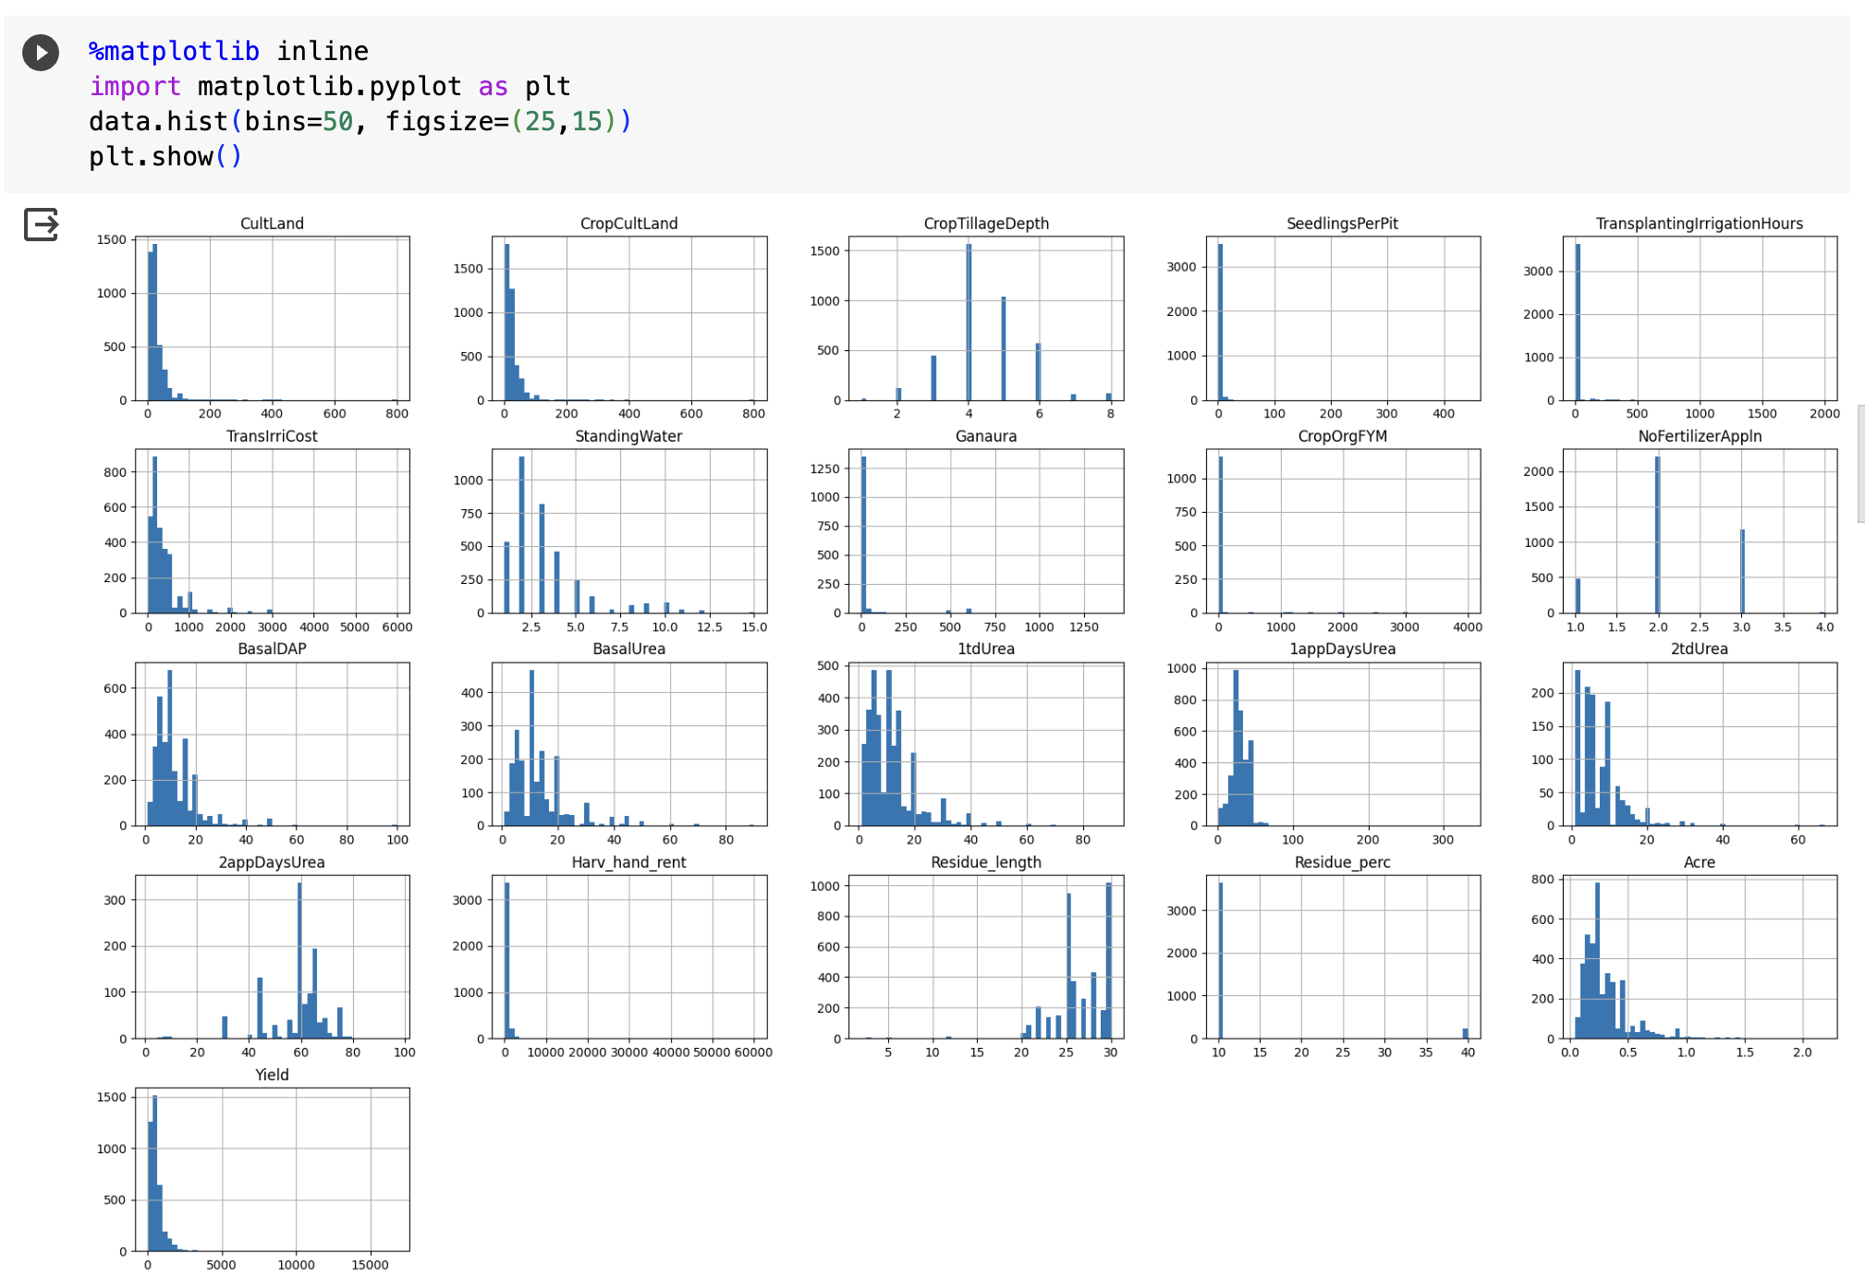
Distribution of the dataset

Slide 7
NEXT STEPS
As we can see in the dataset there are some null values, and we can not drop all the values cause if we do that, lot of information will be lost, so we replace these values either by the values of the column which are most correlated or else we will drop the values.
As we can see there are many columns which are string type and hold values, which can affect the the prediction result, so we’ll use the Label encoder

Slide 8
References: -
Better Data Visualizations: A Guide for Scholars, Researchers, and Wonks
Author: Jonathan Schwabish
https://cup.columbia.edu/book/better-data-visualizations/9780231193115
Deep-LSTM Model for Wheat Crop Yield Prediction in India
Author: - Preeti Saini; Bharti Nagpal
https://ieeexplore.ieee.org/document/9913604
Optimizing Crop Yield in Agriculture using Data Mining and Machine Learning Techniques
Author: - Rashmi Welekar, Charanjeet Dadiyala
https://ieeexplore.ieee.org/document/10170493
Automated Rice Crop Yield Prediction using Sine Cosine Algorithm with Weighted Regularized Extreme Learning Machine
Author: - - S. Thirumal; R. Latha
https://ieeexplore.ieee.org/document/10142403/

